Slide 1
AIML CA2
By: Koh Hui Lyn (p2021672)
DAAA/FT/2A05

Slide 2
01
Time Series
Predicting air pollution values

Slide 3
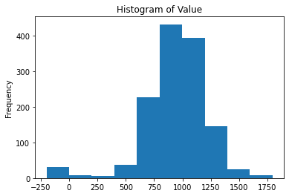
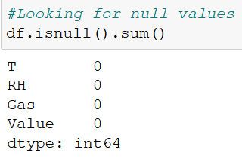
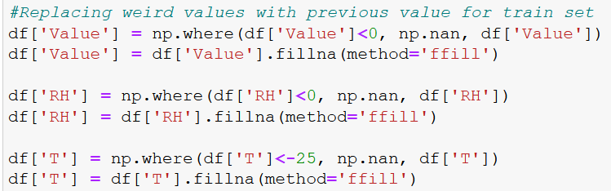
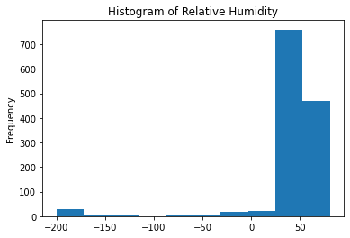
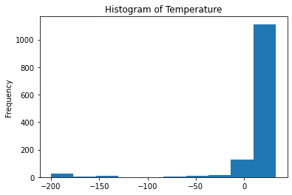
Data Exploration
No nulls, but had weird values
Replaced with the previous value

Slide 4
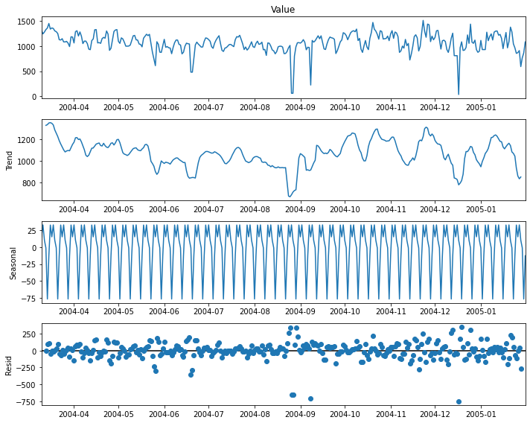
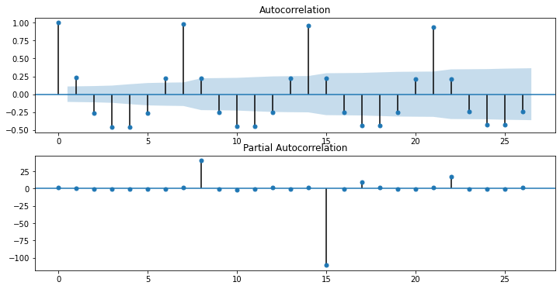
CO
From CO’s decomposition plot we find that:
Data looks stationary
No trend
There is seasonality
From the ACF plot, we find that there is a pattern every 7 days.
Thus, Seasonality is 7

Slide 5
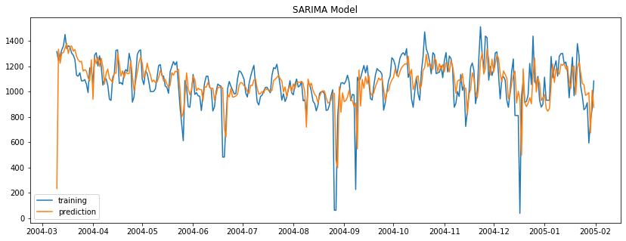
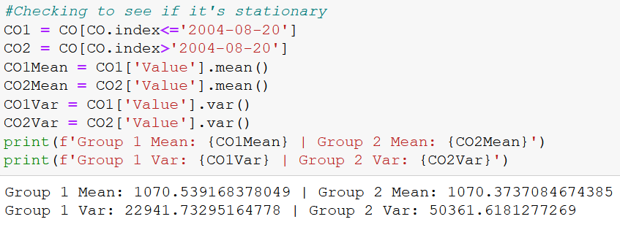
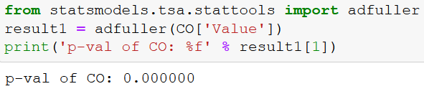
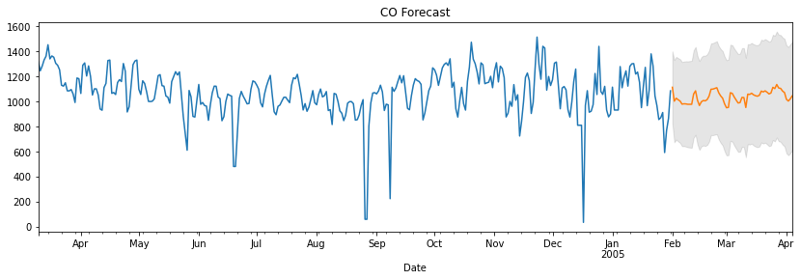
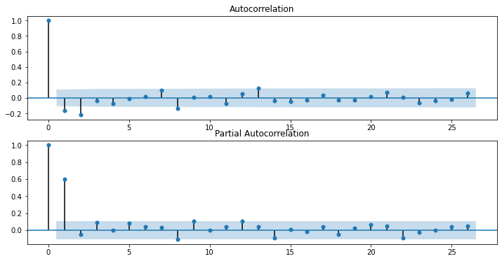
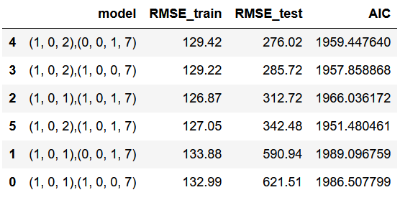
CO
To check if its stationary, I split into 2 groups
The mean of the 2 groups are very similar
Variance is different
To confirm if it’s stationary, conducted Augmented Dicky Fuller Test
P-val of CO is 0 < 0.05. Reject null hypothesis that data doesn’t have a unit root and is stationary
Thus don’t have to do differencing
From ACF:
q = 1 or q = 2
From PACF:
p = 1
d = 0 (didn’t diff)
Seasonality = 7

Slide 6
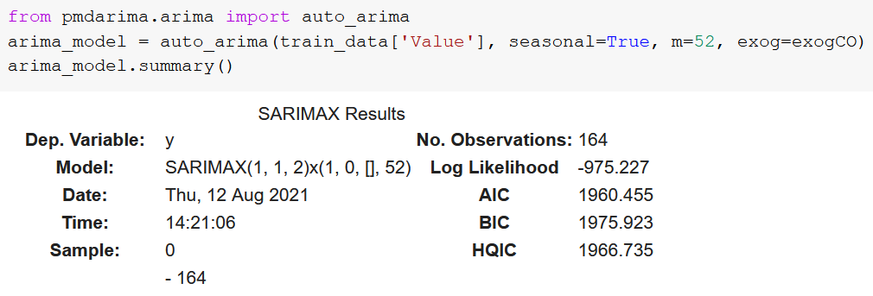
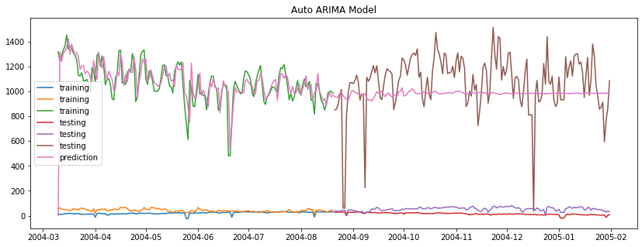
CO
Tried Auto Arima to check model
It brute forced and suggested (1,1,2) because of good AIC score
But our data doesn’t need to diff so I didn’t use this

Slide 7
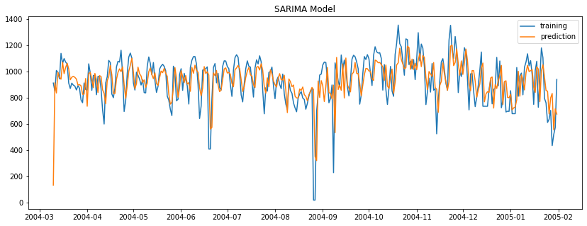
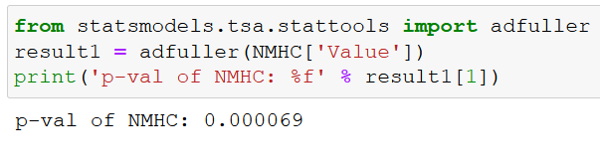
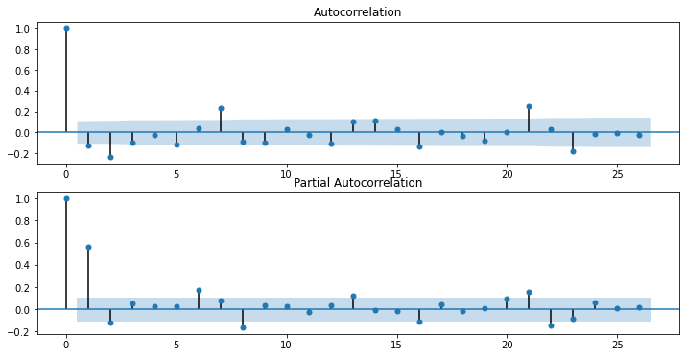
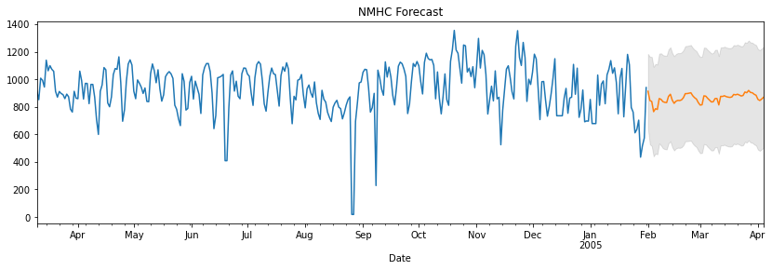
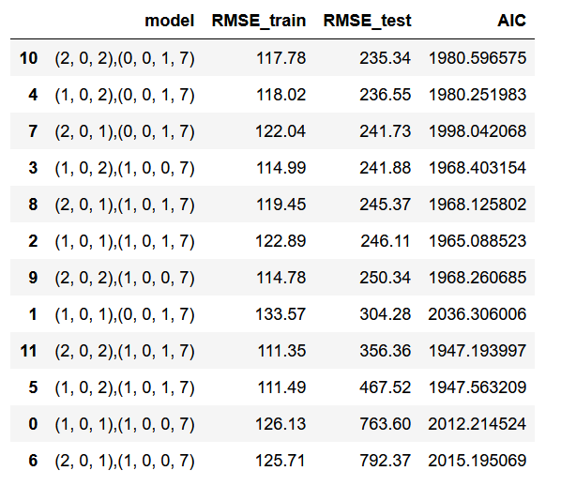
NMHC
P-val of NMHC is 0.000069 < 0.05. Reject null hypothesis that data doesn’t have a unit root and is stationary
From ACF:
q = 1 or q = 2
From PACF:
p = 1 or p = 2
d = 0 (didn’t diff)
Seasonality = 7

Slide 8
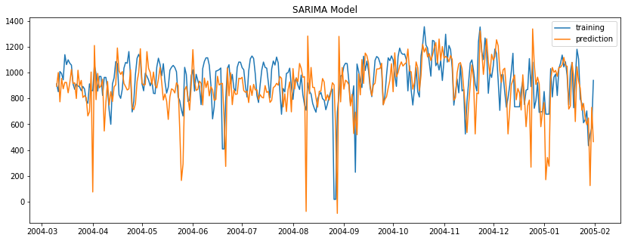
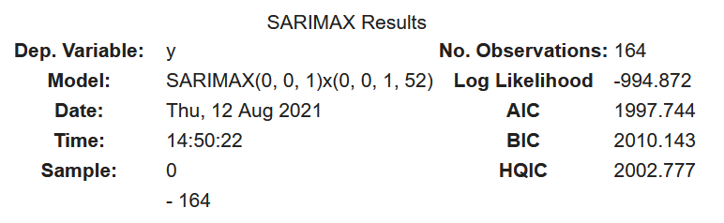
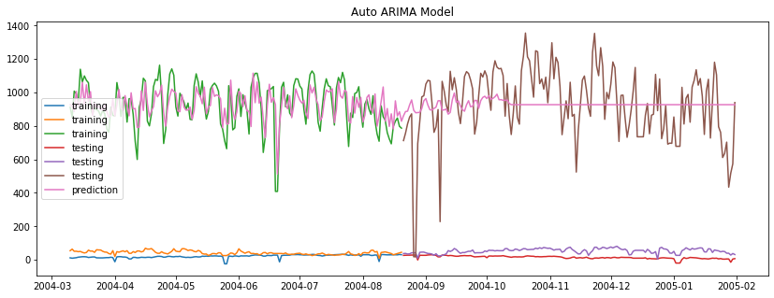
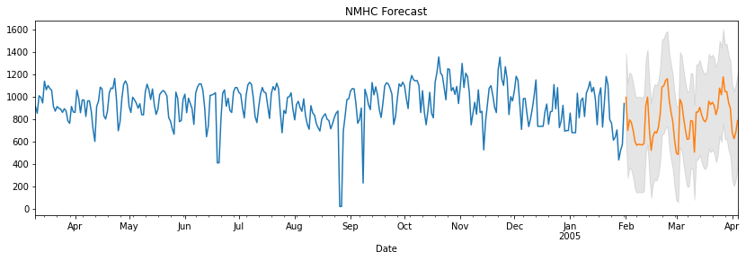
NMHC
Tried Auto Arima to check model
It brute forced and suggested (0,0,1)(0,0,1,52) because of good AIC score
It doesn’t look very fitted to the training graph
It predicts very low values when the actual values aren’t very low
Compared to our original forecast the predictions are bigger
This can be bad as its more likely to be wrong

Slide 9
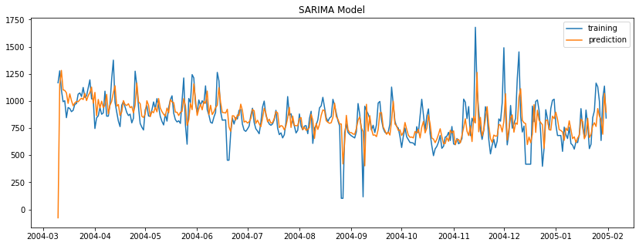
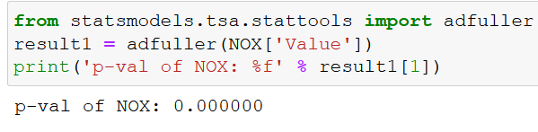
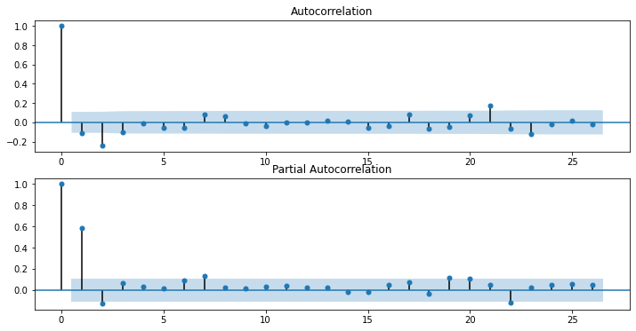
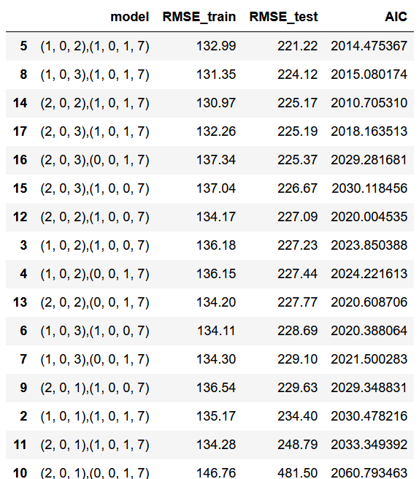
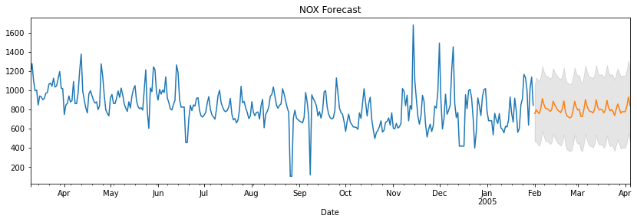
NOx
P-val of NOx is 0 < 0.05. Reject null hypothesis that data doesn’t have a unit root and is stationary
From ACF:
q = 1 or q = 2 or q = 3
From PACF:
p = 1 or p = 2
d = 0 (didn’t diff)
Seasonality = 7

Slide 10
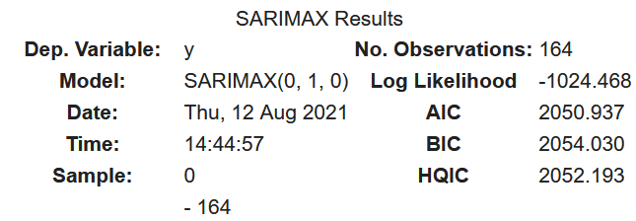
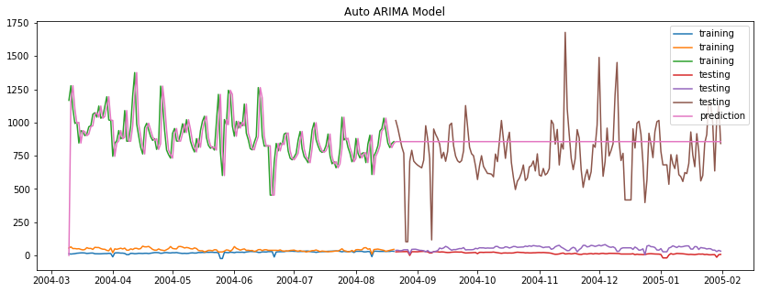
NOx
Tried Auto Arima to check model
It brute forced and suggested (0,1,0) because of good AIC score
But our data doesn’t need to diff so I didn’t use this
Also the predicted graph is a straight line

Slide 11
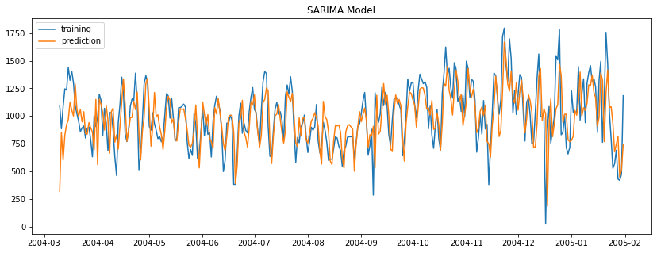
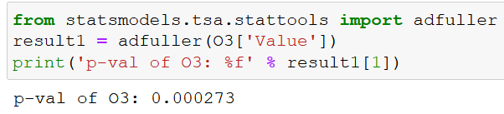
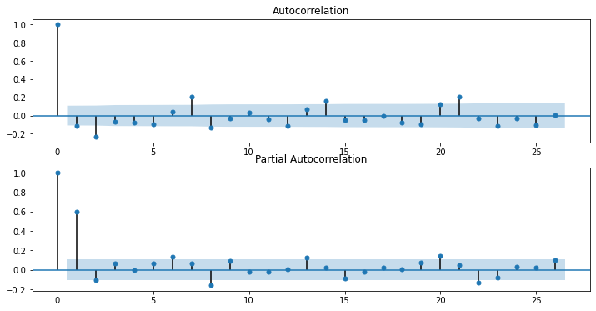
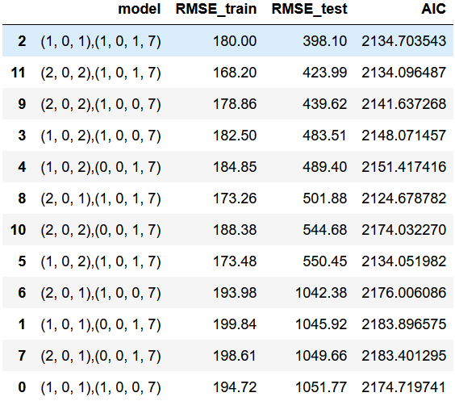
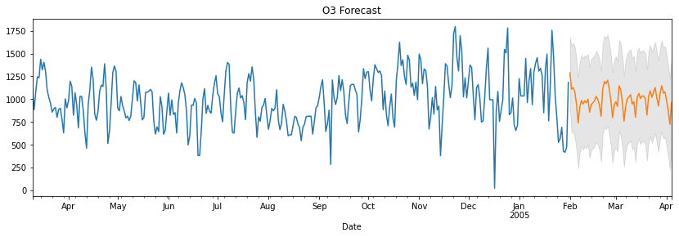
O3
P-val of O3 is 0.000273 < 0.05. Reject null hypothesis that data doesn’t have a unit root and is stationary
From ACF:
q = 1 or q = 2
From PACF:
p = 1 or p = 2
d = 0 (didn’t diff)
Seasonality = 7

Slide 12
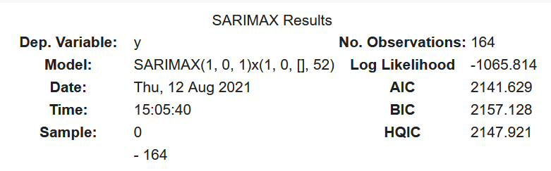
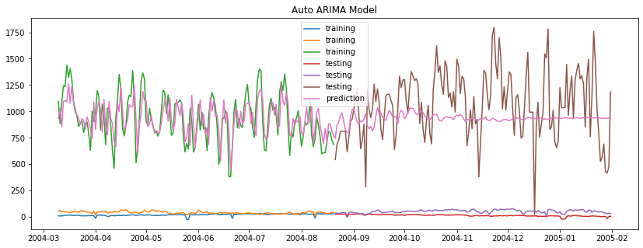
O3
Tried Auto Arima to check model
It brute forced and suggested (1,0,1)because of good AIC score
This is the same as our original Model ☺

Slide 13
02
Unsupervised Learning
Understanding mall customers and how to market to them

Slide 14
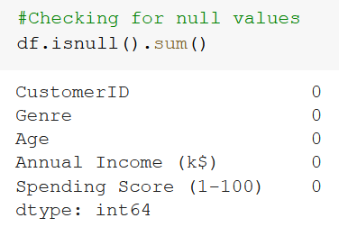
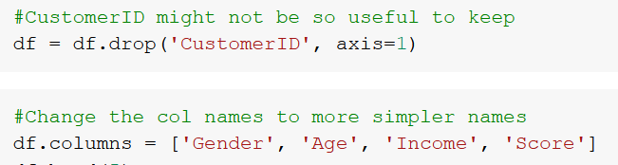
Data Exploration
Dropped CustomerID as it’s just an auto increment number assigned to each customer.
Changed column names to be easier to type.
Checked for null values in dataset

Slide 15
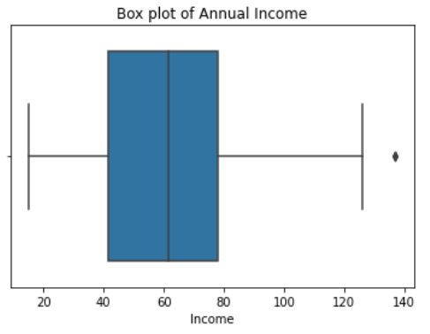
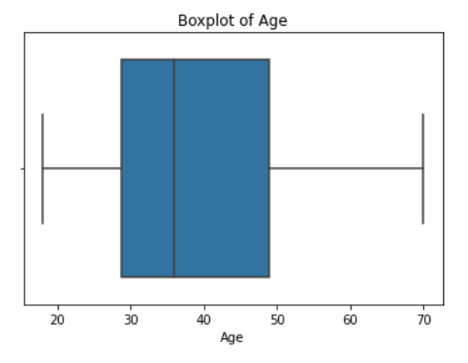
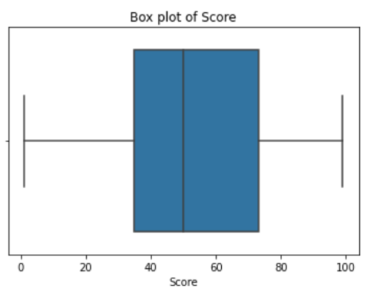
Data Exploration
Has 1 outlier at around ~140K Annual Income
Felt that this annual income was possible as it means ~11.6k a month, so I kept it
Most of the Annual Income of this mall’s customers are between ~40K-80K
Minimum Annual Income is around 15k
Maximum Annual Income of this mall’s customers is around 140k
No outliers
Most of the Age of this mall’s customers are between 30-50
Minimum age of this mall’s customers is around 18
Maximum age of this mall’s customers is around 70
No outliers
Most of the Spending Score of this mall’s customers are between ~35-75
Minimum Spending Score of this mall’s customers is around 1
Maximum Spending Score of this mall’s customers is around 99

Slide 16
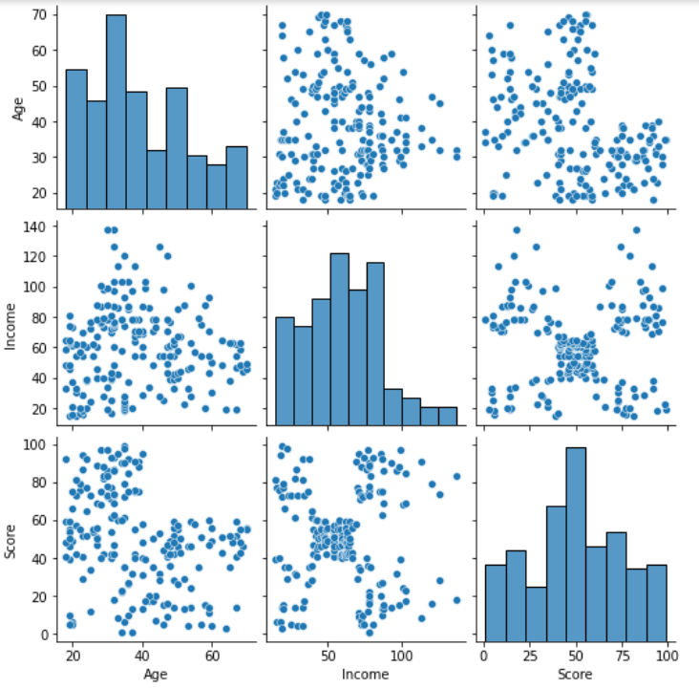
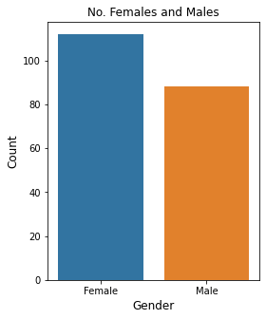
Data Exploration
Checked for relationship between numerical columns in data
Can see that out of these 3, Income and Score got the most visible clusters.
More females than males in this dataset
Unbalanced

Slide 17
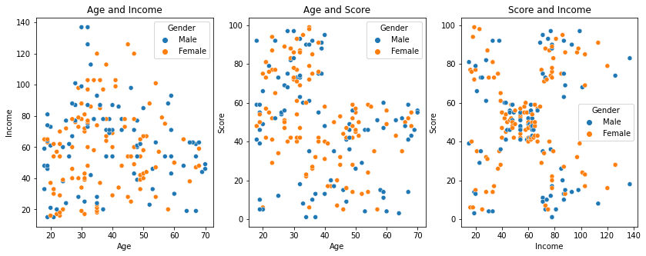
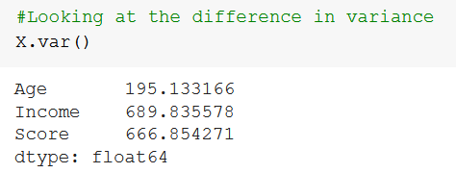
Data Exploration
Columns are <10x magnitude of each other
Don’t need to scale
Cannot find any relationship with Gender and the other columns
Not very useful, so dropped.

Slide 18
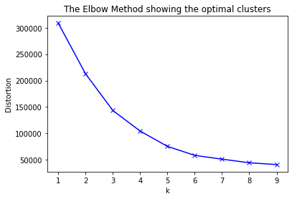
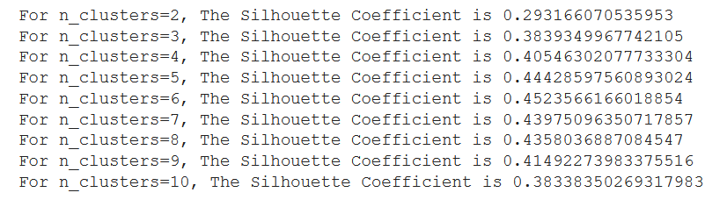
K-Means
N_clusters with the highest Silhouette score is:
n_clusters = 6, Silhouette score = 0.45235
Elbow plot suggests that can use either 5 or 6 clusters
Behind these points the graph gets much flatter

Slide 19
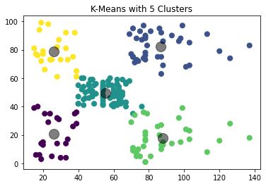

K-Means
Visually the data looks like in 5 clusters
N_clusters = 6 looks like it has some weird clustering in the middle
Using just Score and Annual Income on the axis might not be enough to show how it’s clustered

Slide 20



K-Means
Age is a significant component to separating these clusters as well

Slide 21



Gaussian Mixture Model
The silhouette score for n_components = 6 is the highest at 0.445837
BIC -> n = 5
Distance -> n=4 or n=6
Silhouette -> n=6
Should use n = 6
The lower is the BIC the better
BIC Suggests n_clusters = 5
Good no. of clusters should have
Lesser distance between the 2 GMMS
Error bar small
Distance plot suggests n_clusters = 4 or n_clusters = 6

Slide 22



Gaussian Mixture Model
Looks similar to K-Mean clustering just that center clusters ages are different
I think I would rather use K-Means as:
Silhouette Score Higher
easier to target center 2 clusters as the age groups are smaller

Slide 23




DBScan
DBScan produced very messy clusters
They are hard to separate, so DBScan might not be a good model to use for this data.
Between K-Means and GMM, I decided to go with K-Means as the silhouette score is higher
Best epsilon value at the point of maximum curvature
Epsilon = 8
Min Samples = 2*Dimensions, so 2*3 Columns=6

Slide 24
K-Means Clusters
Cluster 1 is Low-Mid range Age of around 20-35
-Mid - High range Spending Score of around 60-100
-Low-Mid range Annual Income of about $15k-$40k.
-can target this cluster by providing them with discount coupons (ie 20% off Minimum spend $X).
Since these people already visit the store so much, likely to buy more things with this discount and spend more
-Since they are aged 20-35, can target them by giving discounts for shops that they would visit like Electronics, Fashion (maybe H&M, Uniqlo etc)

Slide 25
K-Means Clusters
Cluster 2 is Low-Mid range Age of around 30-40,
-Mid-High range Spending Score of around 60-100
-Mid-High range Annual Income of about $70k-$140k (Most of which falling nearer to $70k than $140k)
-Can target them by having more expensive stores in the mall
Ie maybe have more expensive restaurants/buffets in the mall
Ie can have more expensive brands in the mall like Gucci etc

Slide 26
K-Means Clusters
Cluster 3 is Mid-High range Age of around 40-70
-Low-Mid range Annual Income of around $35k-$70k
-Mid-High range Spending Score of around 35-60
-Can target them by maybe including more resting spots
Ie Tables where they can sit with their friends and gather, and near the tables can have F&B stores so they can sit there and have a bite etc

Slide 27
K-Means Clusters
Cluster 4 is Low-Mid range Age of around 20-40
-Low-Mid range Annual income of around $40k-$75k
-Mid range Spending Score of around 30-60
-Can target them by maybe having free WIFI in the mall as they are younger.
-Then can also have resting spaces for them with F&B nearby

Slide 28
K-Means Clusters
Cluster 5 is Low-High range Age of around 20-60
-Low-Mid range Spending Score of around 1-40
(Most of which being closer to 1 than 40)
-Mid – High range Annual Income of around $70k - $140k (Most being closer to $70k than $140k)
-Have to attract them to spend in the store
-Have more high-class stores
-Can implement a Loyalty rewards scheme ie points system to get them to come back and spend

Slide 29
K-Means Clusters
Cluster 6 is a Low-High range Age of around 20-60
-Low-Mid range Spending Score of around 1-40
-Low-Mid range Annual Income of around $15k-$40k.
-Can give discount coupons for necessities like Supermarkets etc
-Can give deals like buy 5 get 1 free for certain items in the supermarkets

Slide 30
THANK YOU

